Slide 1
Object-Oriented Programming Concepts
Inheritance

Slide 2
Inheritance
In C++, it is possible to inherit attributes and methods from one class to another.
The inheritance concept is grouped into two categories:
  derived class (child or sub class) - the class that inherits from another class
  base class (parent or super class) - the class being inherited from
To inherit from a class, use the : symbol.

Slide 3
Inheritance
The main advantage of using inheritance is reusability:
  i.e. when we want to create a new class and there is already a class that includes some of the code that we want, we can derive our new class from the existing class.
  By so doing, we are reusing the fields and methods of the existing class.
  This makes it easier to create and maintain an application.
In the next example, the Car class (child) inherits the attributes and methods from the Vehicle class (parent):

Slide 4
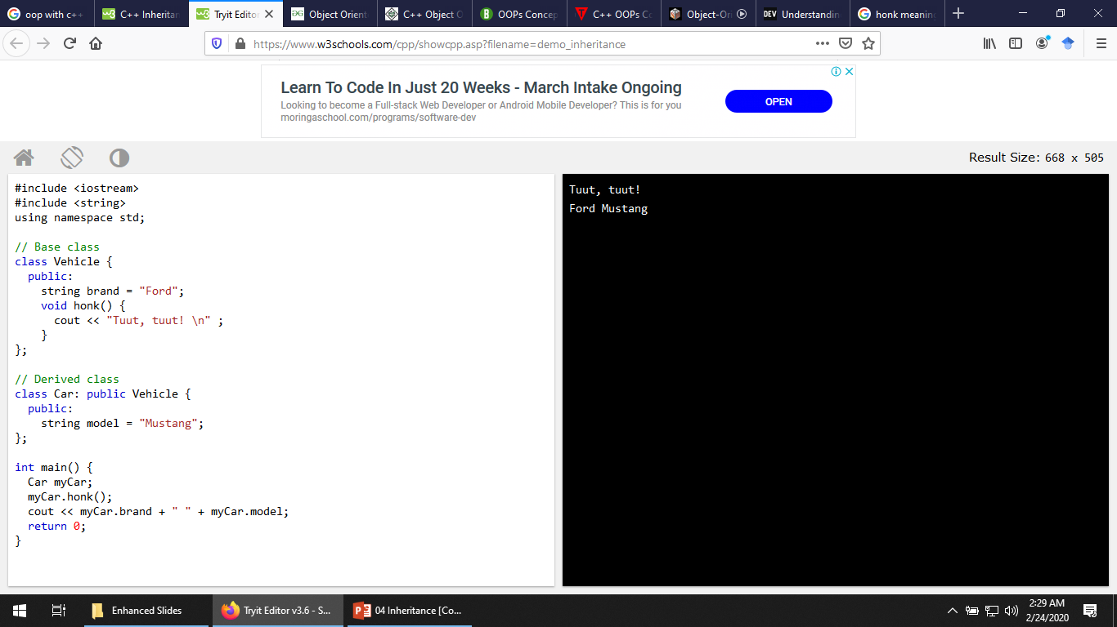
3-<number>
Notes:
Creation of an object is called instantiation (of its class).

Slide 5
Types of Inheritance in C++
There are different types of inheritance as listed below:
  Single inheritance
  Multilevel inheritance
  Hierarchical inheritance
  Hybrid inheritance

Slide 6
Single Inheritance
In this type of inheritance, one class inherits one class.
Lets say we have class A and B, if B inherits A, this is called single inheritance as shown in the example that follows:

Slide 7
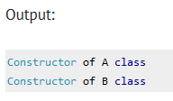
#include <iostream>
using namespace std;
class A {
public:
A(){
cout<<"Constructor of A class"<<endl;
}
};
class B: public A {
public:
B(){
cout<<"Constructor of B class";
}
};
int main() {
//Creating object of class B
B obj;
obj.A();
obj.B();
return 0;
}
3-<number>
Notes:
Creation of an object is called instantiation (of its class).

Slide 8
Multiple Inheritance
A class can also be derived from one class, which is already derived from another class, i.e. one class inherits another child class
  In the next example, MyGrandChild is derived from class MyChild (which is derived from MyClass).

Slide 9
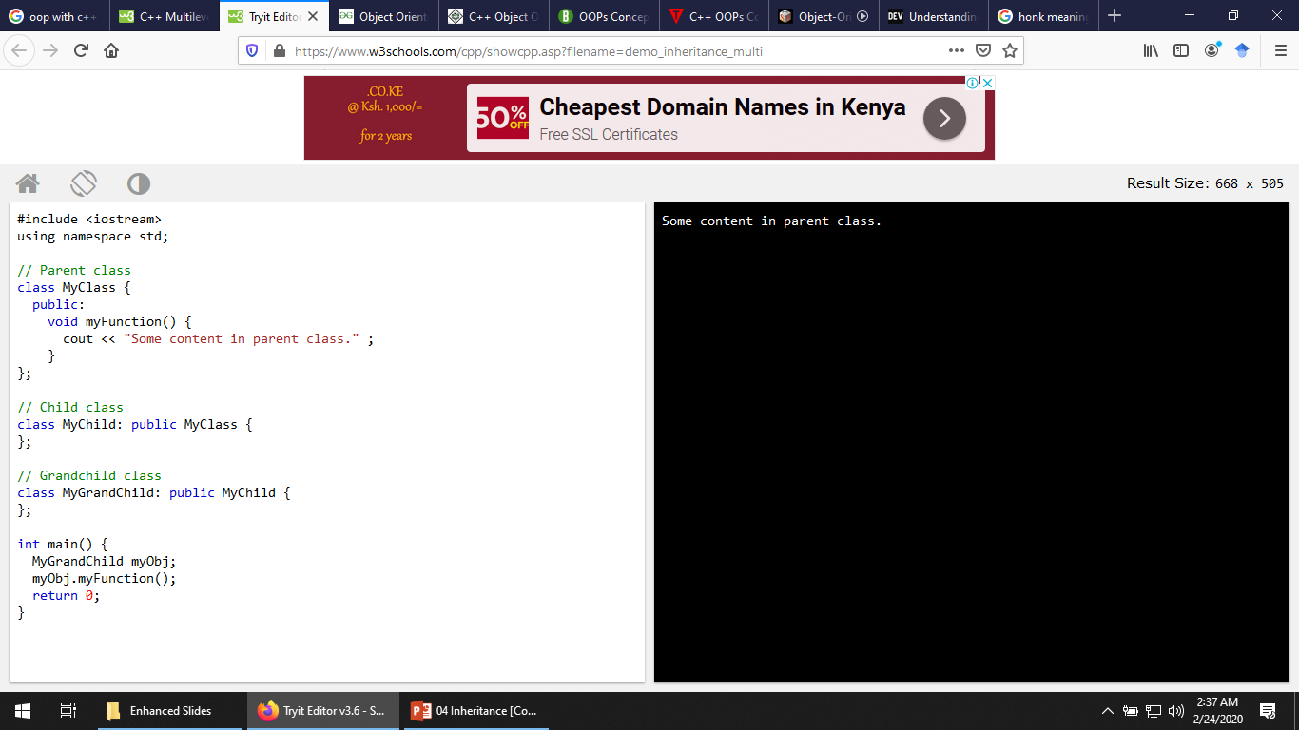
3-<number>
Notes:
Creation of an object is called instantiation (of its class).

Slide 10
Multiple Inheritance
A class can also be derived from more than one base class, using a comma-separated list
  a class can inherit more than one class.
  This means that in this type of inheritance a single child class can have multiple parent classes.

Slide 11
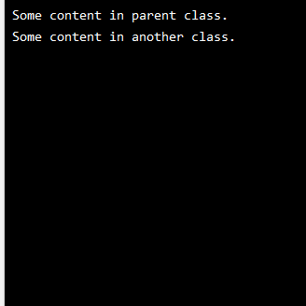
#include <iostream>
using namespace std;
// Base class
class MyClass {
public:
void myFunction() {
cout << "Some content in parent class.\n" ;
}
};
// Another base class
class MyOtherClass {
public:
void myOtherFunction() {
cout << "Some content in another class.\n" ;
}
};
// Derived class
class MyChildClass: public MyClass, public MyOtherClass {
};
int main() {
MyChildClass myObj;
myObj.myFunction();
myObj.myOtherFunction();
return 0;
}
3-<number>
Notes:
Creation of an object is called instantiation (of its class).

Slide 12
Hierarchical Inheritance
In hierarchical inheritance, one parent class has more than one child class as shown in the next example where Class B and C inherits class A:

Slide 13
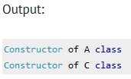
#include <iostream>
using namespace std;
class A {
public:
A()
{
cout<<"Constructor of A class"<<endl;
}
};
class B: public A {
public:
B()
{
cout<<"Constructor of B class"<<endl;
}
};
class C: public A{
public:
C()
{
cout<<"Constructor of C class"<<endl;
}
};
int main()
{
//Creating object of class C
C obj;
obj.A();
obj.C();
return 0;
}
3-<number>
Notes:
Creation of an object is called instantiation (of its class).

Slide 14
#include <iostream>
using namespace std;
class Shape // Declaration of base class.
{
public:
int a;
int b;
void get_data(int n,int m)
{
a= n;
b = m;
}
};
class Rectangle : public Shape // inheriting Shape class
{
public:
int rect_area()
{
int result = a*b;
return result;
}
};
3-<number>
Notes:
Creation of an object is called instantiation (of its class).

Slide 15
class Triangle : public Shape // inheriting Shape class
{
public:
int triangle_area()
{
float result = 0.5*a*b;
return result;
}
};
3-<number>
Notes:
Creation of an object is called instantiation (of its class).

Slide 16
int main()
{
Rectangle r;
Triangle t;
int length,breadth,base,height;
std::cout << "Enter the length and breadth of a rectangle: " << std::endl;
cin>>length>>breadth;
r.get_data(length,breadth);
int m = r.rect_area();
std::cout << "Area of the rectangle is : " <<m<< std::endl;
std::cout << "Enter the base and height of the triangle: " << std::endl;
cin>>base>>height;
t.get_data(base,height);
float n = t.triangle_area();
std::cout <<"Area of the triangle is : " << n<<std::endl;
return 0;
}
3-<number>
Notes:
Creation of an object is called instantiation (of its class).

Slide 17
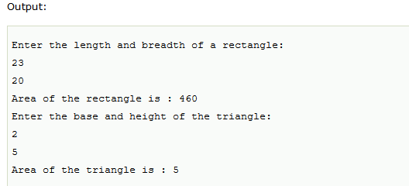
3-<number>
Notes:
Creation of an object is called instantiation (of its class).

Slide 18
Hybrid Inheritance
Hybrid inheritance is a combination of more than one type of inheritance.
For example:
  A child and parent class relationship that follows multiple and hierarchical inheritance both can be called hybrid inheritance.

Slide 19
#include <iostream>
using namespace std;
class A {
protected:
int a;
public:
void get_a()
{
std::cout << "Enter the value of 'a' : " << std::endl;
cin>>a;
}
};
class B : public A {
protected:
int b;
public:
void get_b()
{
std::cout << "Enter the value of 'b' : " << std::endl;
cin>>b;
}
};
3-<number>
Notes:
Creation of an object is called instantiation (of its class).

Slide 20
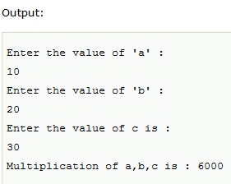
class C {
protected:
int c;
public:
void get_c()
{
std::cout << "Enter the value of c is : " << std::endl;
cin>>c;
}
};
class D : public B, public C{
protected:
int d;
public:
void mul()
{
get_a();
get_b();
get_c();
std::cout << "Multiplication of a,b,c is : " <<a*b*c<< std::endl;
}
};
int main()
{
D d;
d.mul();
return 0;
}
Notes:
Creation of an object is called instantiation (of its class).

Slide 21
Access Specifiers
We learned earlier that there are three specifiers available.
However, we have only used:
  public (members of a class are accessible from outside the class) and,
  private (members can only be accessed within the class).
The third specifier, protected, is similar to private, but it can also be accessed in the inherited class as shown in the example that follow.

Slide 22
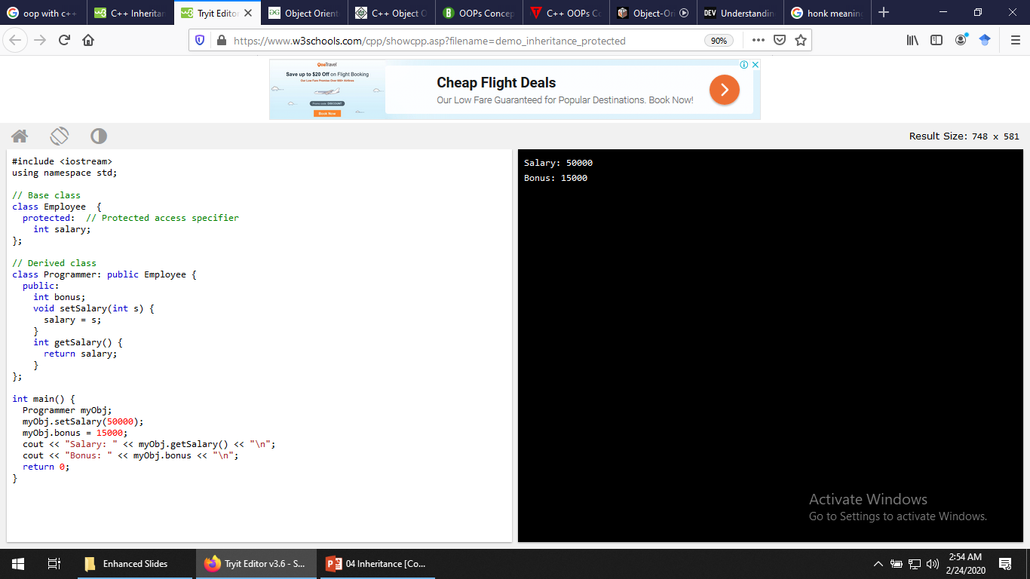
3-<number>
Notes:
Creation of an object is called instantiation (of its class).

Slide 23
References
https://www.w3schools.com/cpp/cpp_inheritance.asp
https://beginnersbook.com/2017/08/cpp-polymorphism/

